Slide 1
Let’s talk: Cyber security Laois County Council

Slide 2
Laois’s cyber security team

Slide 3
Why do we have a Dedicated cyber security team?
Traditionally, we worked within a building with servers on a 8am-6pm availability & work patterns
Now, we work from a 24/7 availability, with cloud-based software systems and remote working available from anywhere
We are much more ‘internet-connected’, meaning the threat of bad actors / hackers / nation state adversaries are ever present.

Slide 4
Threat of ‘Ransomware’
Attackers gain access to systems and encrypt all your data, they look for a ransom to get your data back.
They also threaten to release your data, thus incurring Data Protection fines
Laois County Council’s reputational damage will suffer if an attack takes place
Biggest ransomware attack in the Irish state was the HSE attack in 2021
Other threats include standard viruses and malware, website defacement, financial fraud, phishing and password attacks etc.
Unfortunately, despite investing in cyber security staff, firewalls, industry-leading antivirus and protection systems, bad actors always target staff through fake emails – this is known as email ‘phishing’.

Slide 5
Laois County Council – Environment *approximation
Staff | 600
Mailboxes | 560
🖥 Desktops | 80
💻 Laptops | 380
📱 Mobiles | 350
🗄 Servers | 45
🔥 Firewalls | 3
Websites | 4

Slide 6
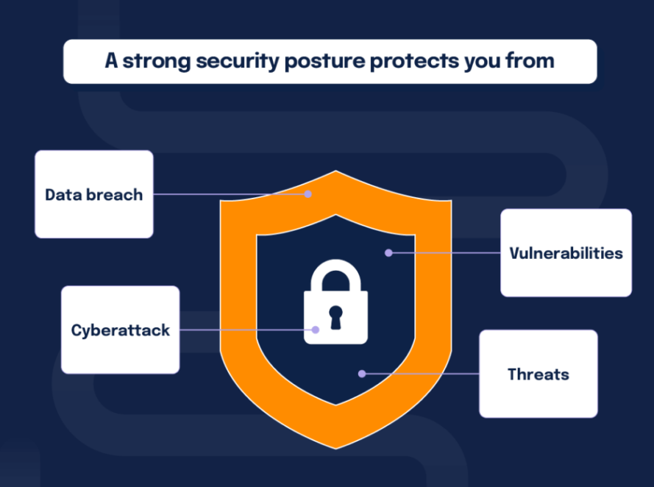
How to Improve your Business Security Posture?
Strong password policy (enforce MFA)
Zero Trust & Conditional Access
Keep software and systems updated
Staff training on security awareness
Use endpoint protection and monitoring tools
Research cloud services with built-in security.
Backup data regularly.

Slide 7
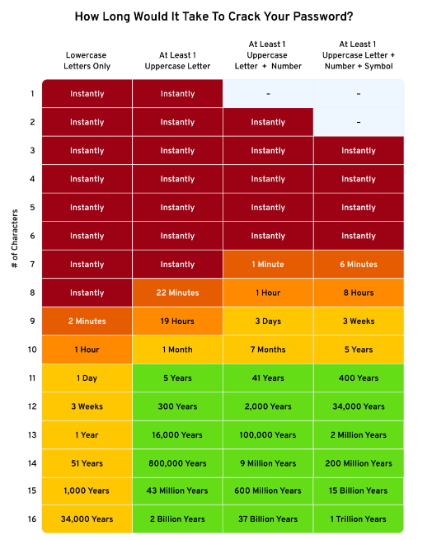
Password – Best Practices
Enforce a strong password policy (14 Chars)
Length over complexity
Never reuse passwords
Enable MFA – Multi Factor Authentication.
Lock account after “x” number of failed logins.
Use a reputable password manager software
Do not share passwords!

Slide 8
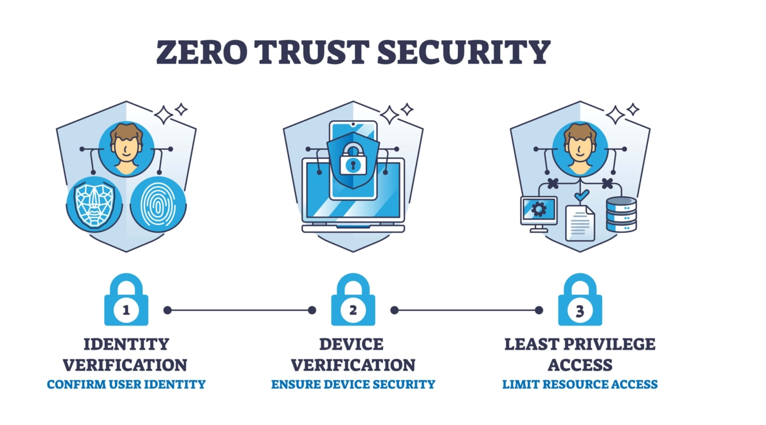

Slide 9
Phishing threat
What is phishing and how can I protect myself?
Phishing is the attempt to obtain sensitive information such as usernames, passwords, and credit card details, often for malicious reasons, by disguising as a trustworthy entity in an electronic communication.
The best way to protect yourself from phishing is to learn how to recognize a phish.
Employees are often the most targeted link in a company’s security chain. But with a little knowledge and foresight you can mitigate the risks.

Slide 10
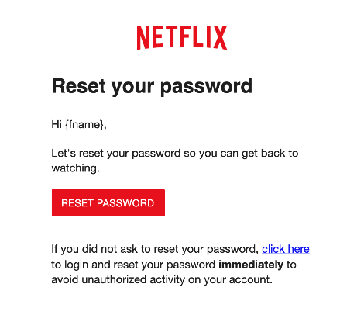
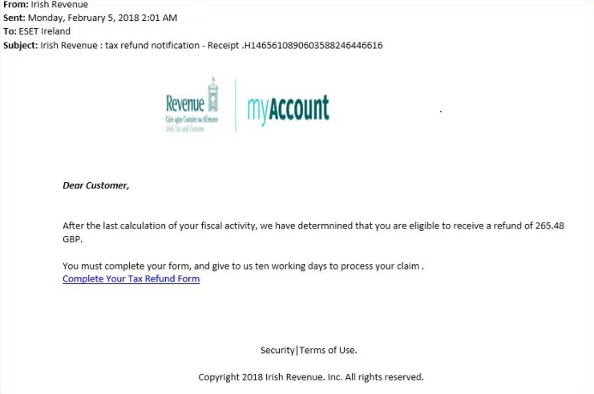
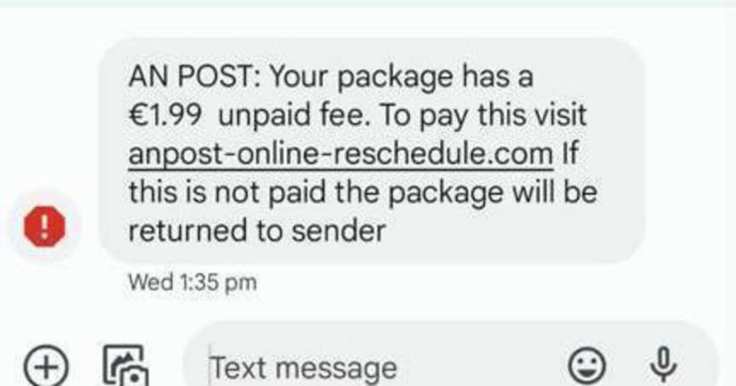
Phishing Examples

Slide 11
How to identify a phishing email
Don’t Trust the Display Name – Always check the email address in the “From” header – if this looks suspicious, report the email
Look but Don’t Click
Don’t trust any email that has urgency attached to it – “Your account will lock if you don’t proceed immediately”
Check for Spelling Mistakes or Vagueness
Review the Signature

Slide 12
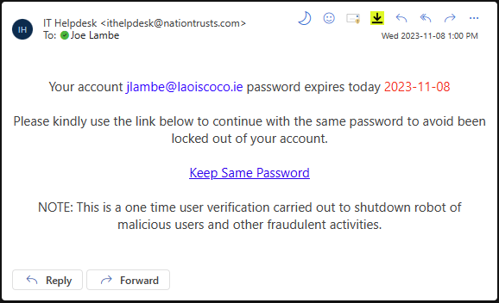

Slide 13
Phish Campaign– Lessons Learned
Note the From Address
You will never receive a link to reset your password from IT.
‘The “From” address is the main indicator of a fraudulent email. Be sure to check this address if unsure of sender.
All staff have migrated to 14 character length password policy, we don’t send any links to reset password.

Slide 14
Staff training
Laois’s Cyber security team periodically run test phish campaigns, targeting all staff with a sample phish email.
Staff who click on the links will be classified in a higher-risk category
These staff can be subject to auto-enrollment in further training videos and training exercises by the cyber security team.
Ongoing exposure to phishing campaigns has reduced click rate of LCC staff from 20%+ in early 2023 to 2% in most previous campaign (Feb 2025).

Slide 15
Useful links and Resources
https://www.ncsc.gov.ie/guidance/ - Guidance Documents released by the NCSC
https://cybersafety.ie/ - Accessible cyber-security resources for all.
https://www.localenterprise.ie/Laois/ - Training and Events
https://haveibeenpwned.com/ - Check if your email address is in a data breach
https://www.virustotal.com/ - Analyse suspicious files, domains, Ips and URLs
https://csat.cisecurity.org/ - Guided security self-assessment portal.
https://whatismyipaddress.com/ - IP address checker.

Slide 16
Thank You! Any Questions?

