Slide 1
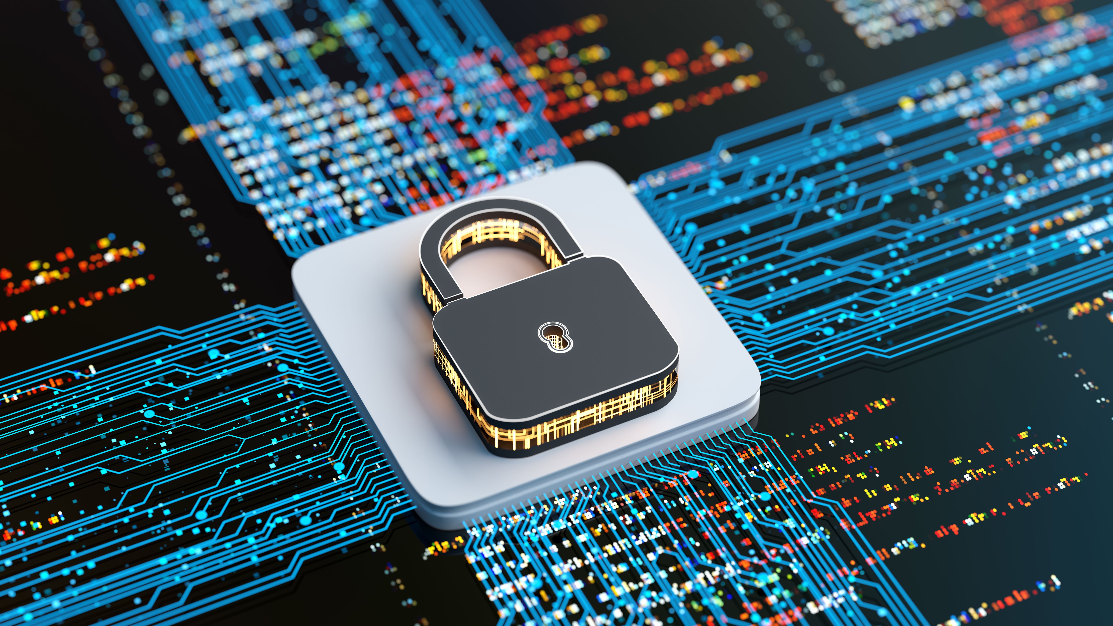
Cybersecurity Advice from Blacknight
by Alan O’Reilly
Customer Experience Manager

Slide 2
The Cybersecurity Landscape in 2025
Amplified Threats
AI-powered attacks 300% more sophisticated
Small Business Impact
62% face cyber attacks annually
Costly Consequences
€120,000 average breach cost
Survival Risk
60% close within 6 months of breach

Slide 3
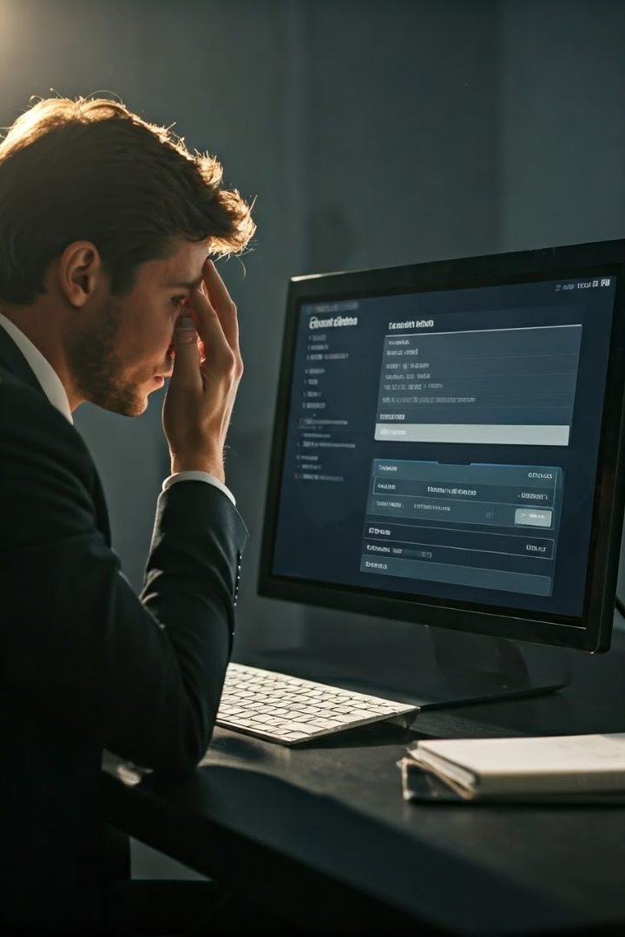
Domain Holder: Are You in Control of Your Own Domain Name?
Digital Identity
Your domain is your online storefront
Common Risks
Expiration, unauthorized transfers, hijacking
Keep Control
Prevent costly domain loss
Legal Ownership and Control
When a domain Is registered in your name, you are the legal owner.
This gives you full authority.

Slide 4
DNS and Domain Control Panel:
Secured with 2FA?
DNS Roles
Risks
2FA Benefits
Blacknight Security
Controls emails and website access
Unsecured panels invite cybercriminals
Reduces unauthorized access by 99.9%
Strong 2FA and DNS protection protocols

Slide 5
Websites: Kept Up-to-Date for Security Updates
Patch Vulnerabilities
Avoid Malware Infections
68% breaches exploit outdated software
Malware can steal data and slow down your site
Protect Sensitive Data
Common Targets
Helps ensure data protection
WordPress suffers 90,000+ attacks per minute

Slide 6
Invoice and CEO Fraud Emails Risk:
DKIM, SPF,
Fraud Type
Email Authentication
These are not technical hacks; they rely on social
engineering to trick people
Ensure your domain has proper email authentication
Operational Disruption
Stay Vigilant
Investigations efforts consume time and resources
Train staff on phishing awareness

Slide 7
Social Media Accounts Secured
Account Risks
Security Tips
Monitoring
Hijacking damages reputation and sales
Strong passwords and 2FA for all accounts
Real-time alerts on suspicious activity

Slide 8
Backup and Disaster Recovery for Cloud Services
1
Regular Backups
2
Disaster Recovery
Automatic snapshots for critical data
Fast restoration minimises downtime
3
Human Error
4
Peace of Mind
Mistakes happen! Files are deleted, misconfigured
or overwritten
Protect your business continuity

Slide 9
Broadband Connectivity Backup
Connectivity Risks
Internet outages disrupt business operations
Backup Options
Connections into your building
Your Internet Provider
Can you ring and talk to your provider for updates when things go wrong

